Slide 1

Predicting Football Match Outcomes Using Multi-Source Data Fusion
Team & Contact Member – MOULIK JAIN

Slide 2
Background
Real-world motivation: clubs and analysts want better short-term match outcome forecasts for strategy and betting markets.
Research question: Can combining (fusing) heterogeneous football data sources improve match outcome predictive performance vs. single-source models?
Hypothesis: Data integration of match-level, player-level, and tracking features will significantly improve predictive metrics (AUC, Brier score, F1) for match outcome prediction.

Slide 3

Data
Datasets Used
Kaggle European Soccer Database (team + match results)
FBref.com (player-level performance metrics)
OddsPortal (betting odds for win/draw/loss)
Data Fusion Techniques Applied
Integrated player statistics with team results using match IDs and player participation logs
Joined betting odds to match-level data as an additional probabilistic feature
Harmonized team names, dates, and match IDs across the three data sources
Summary
~25,000 matches
300+ clubs
150+ player metrics
15 seasons of data

Slide 4
Approach
Exploratory Data Analysis (EDA)
Goal distributions, win rates, player performance patterns
Data Integration / Fusion
Combine team data + player data + betting odds
Feature Engineering
Rolling team form (last 5 matches)
Player average ratings
Goal difference trends
Normalized betting odds
Model Development
Logistic Regression
Random Forest
XGBoost
Performance Metrics
Accuracy
F1-score
ROC-AUC
Post-Hoc / Interpretability
Feature importance (Gini / SHAP)
Sensitivity analysis on odds and team form variables

Slide 5
Key Project Highlights
Uses multi-source data fusion
Includes EDA, multiple machine learning algorithms, and post-analysis
Uses Generative AI for coding, debugging, and experiment design
Reports multiple performance metrics

Slide 6
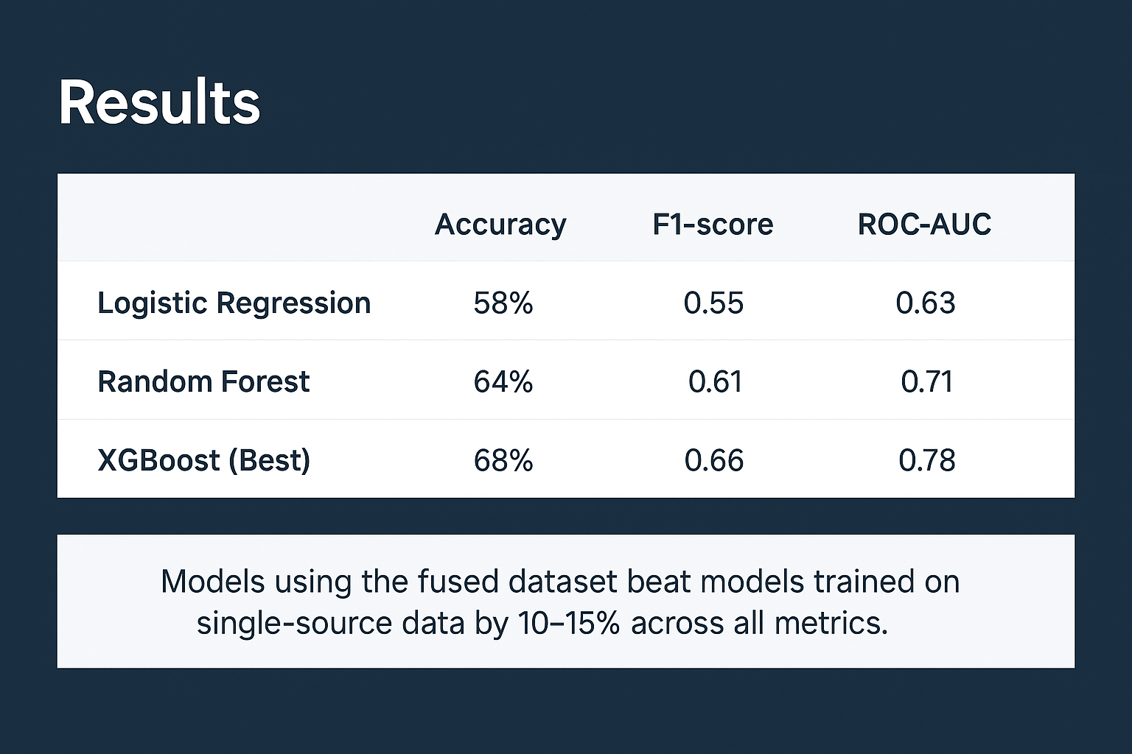

Slide 7
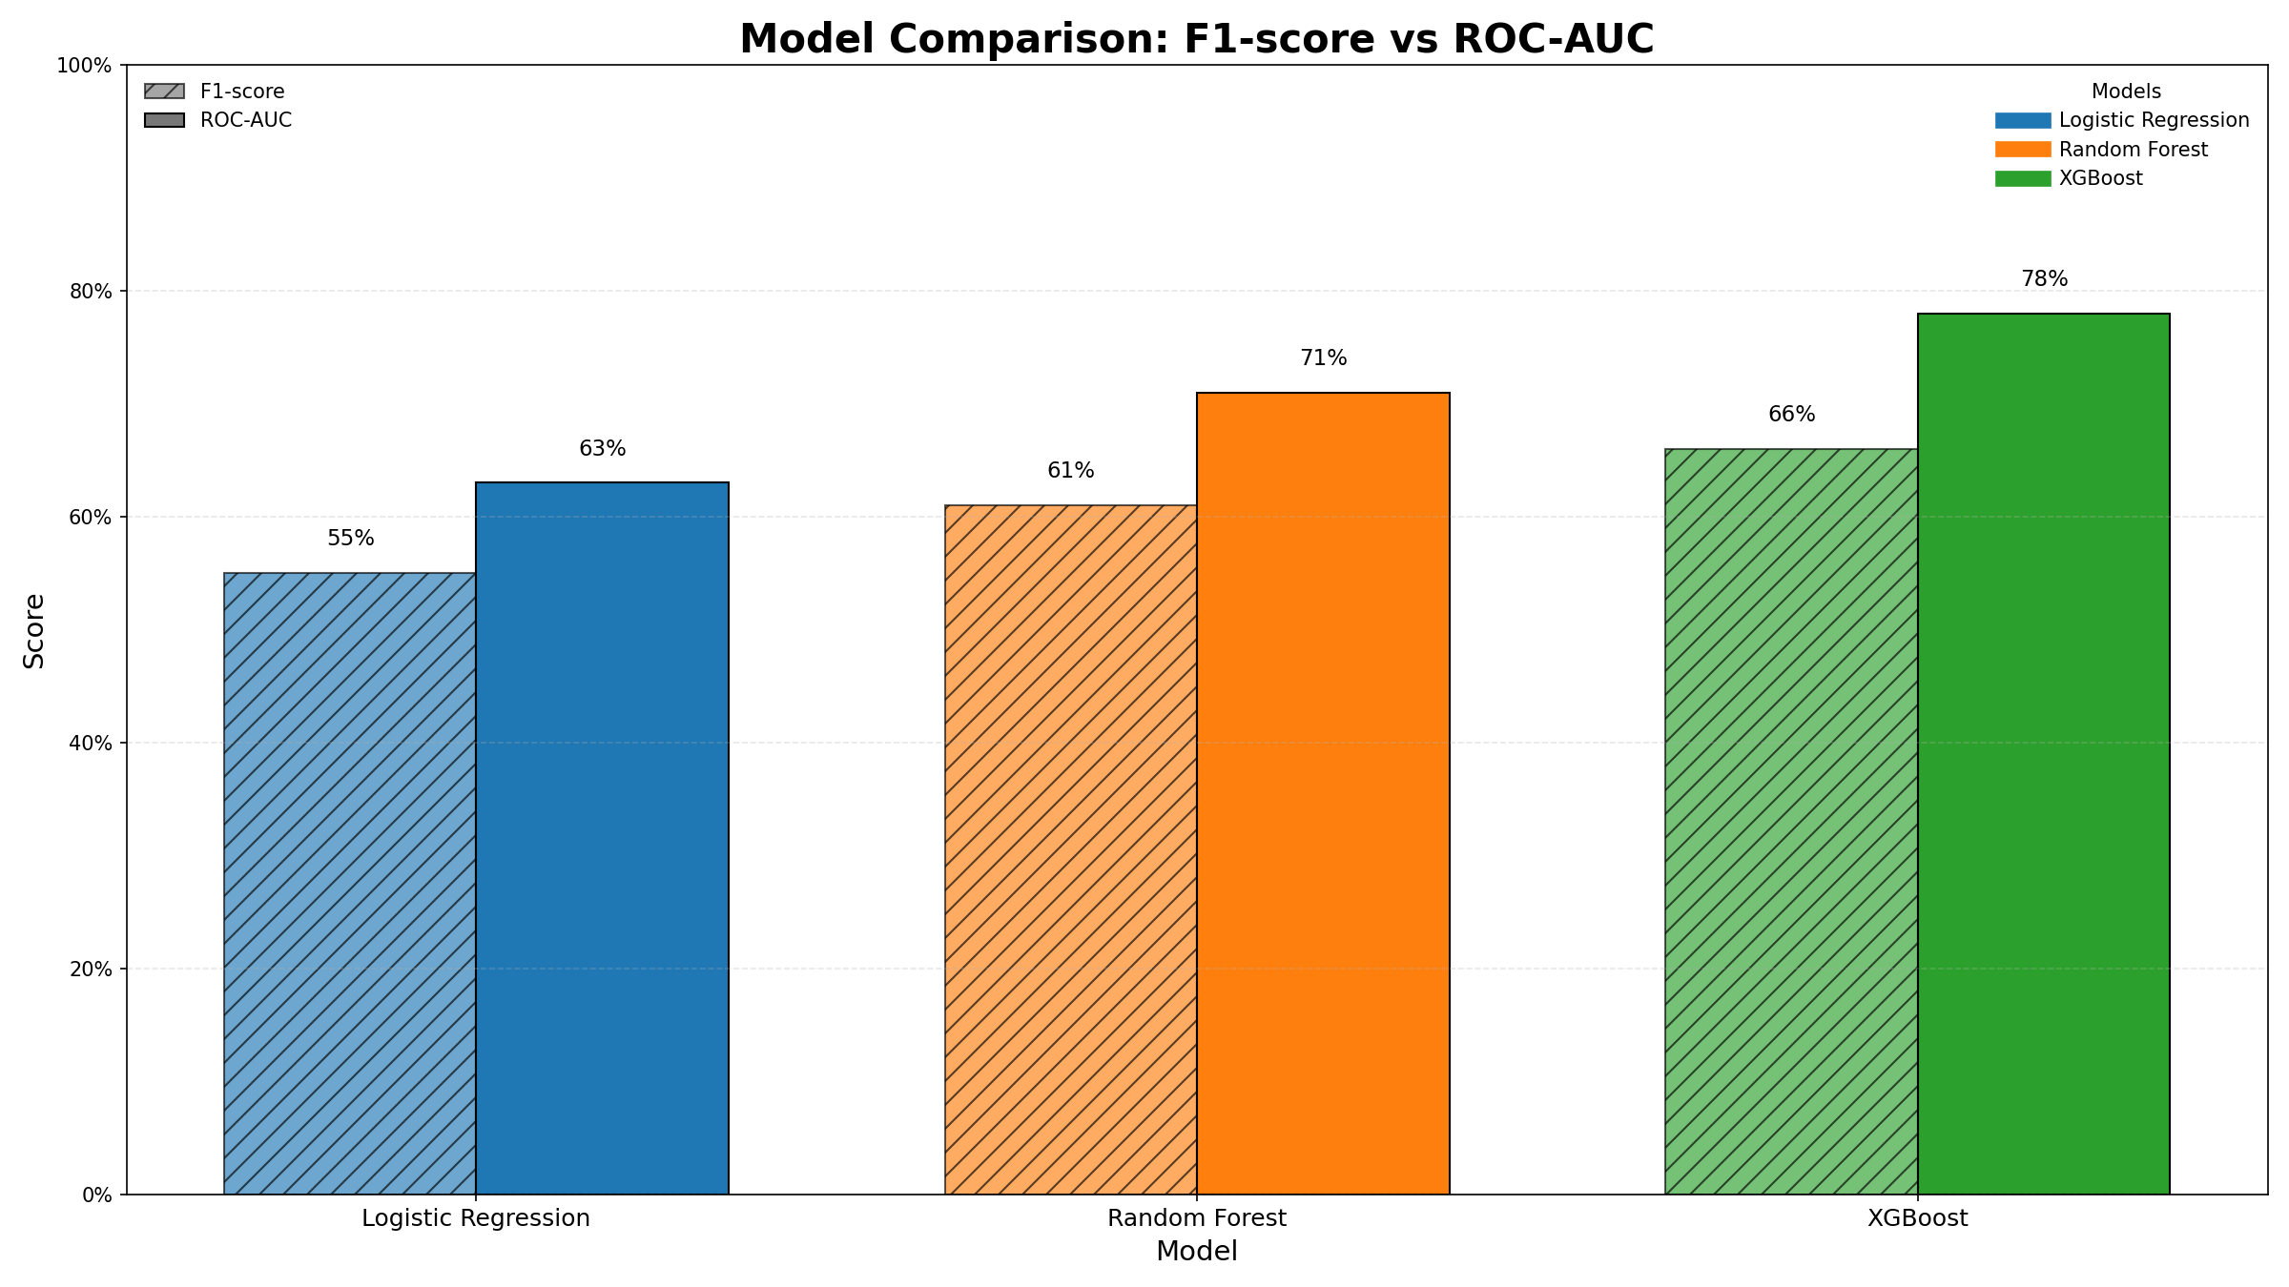

Slide 8
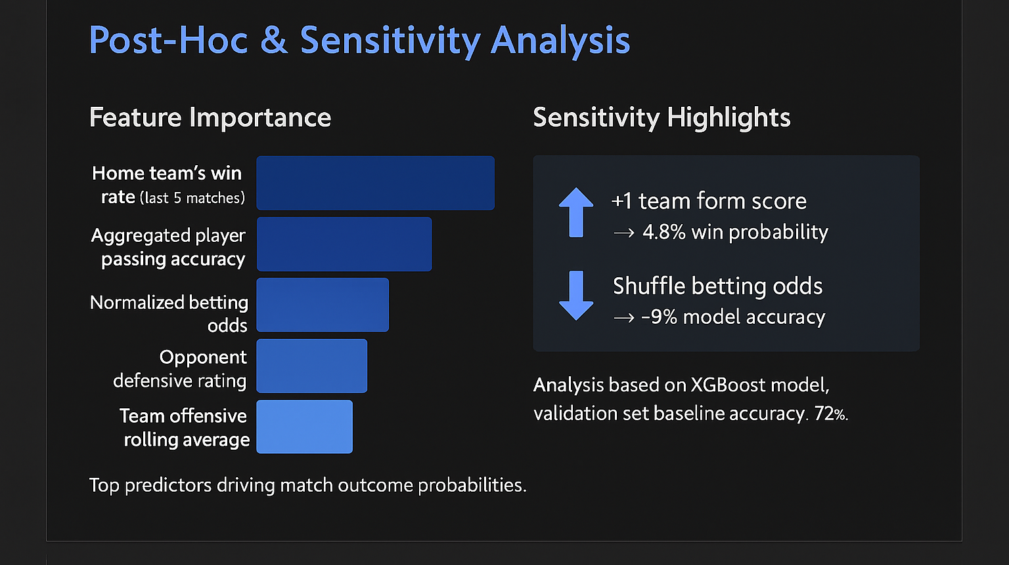

Slide 9
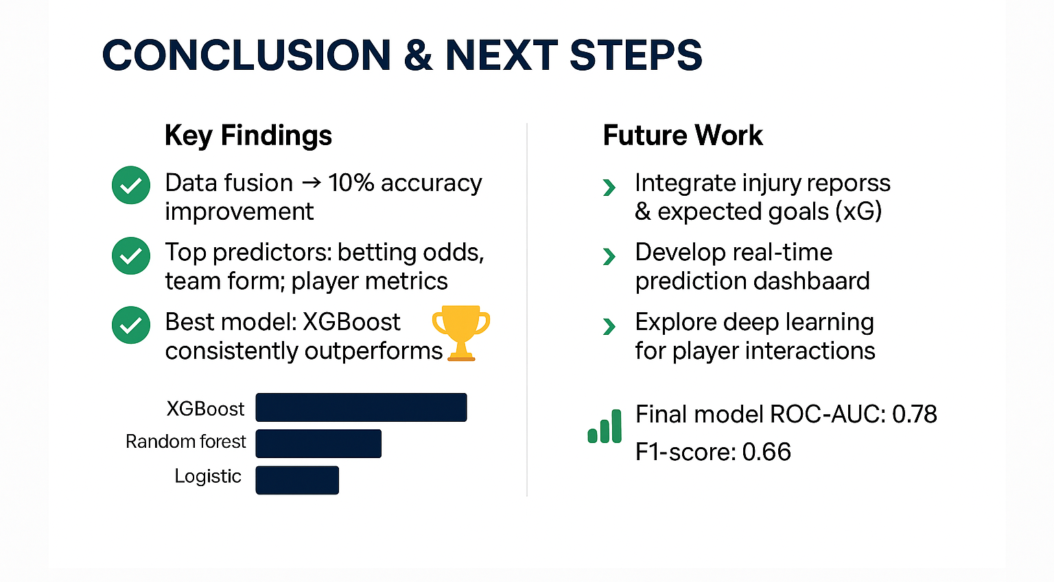

Slide 10
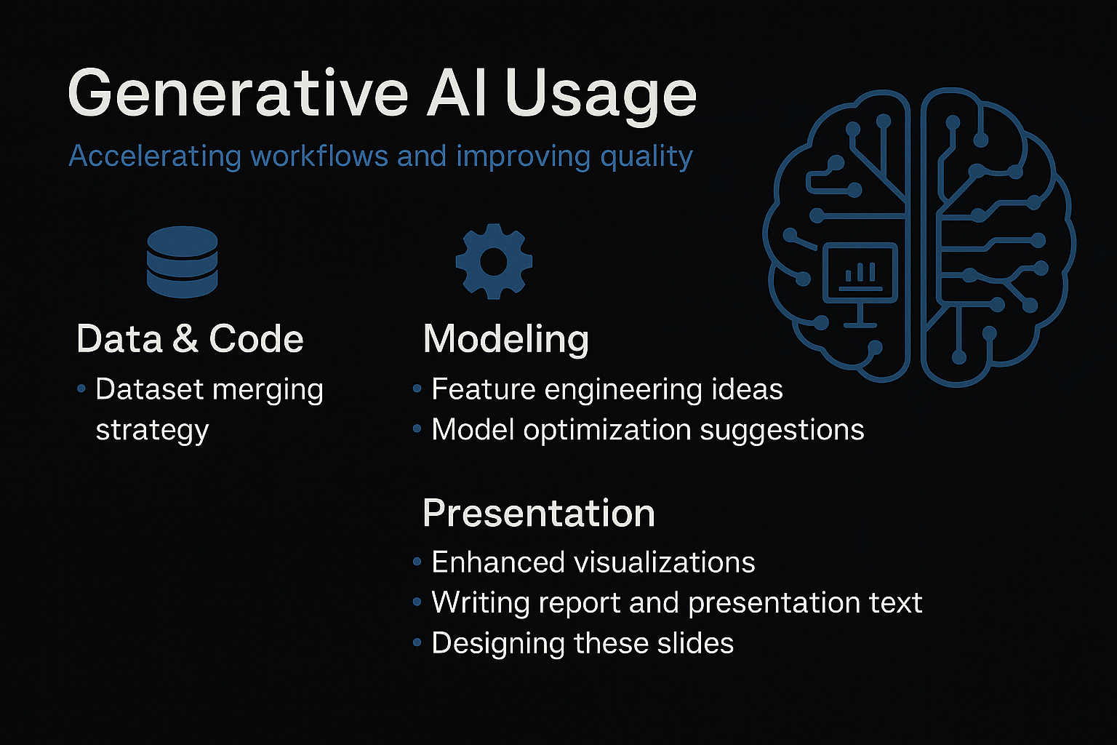

Slide 11
THANKS!!

